Slide 1
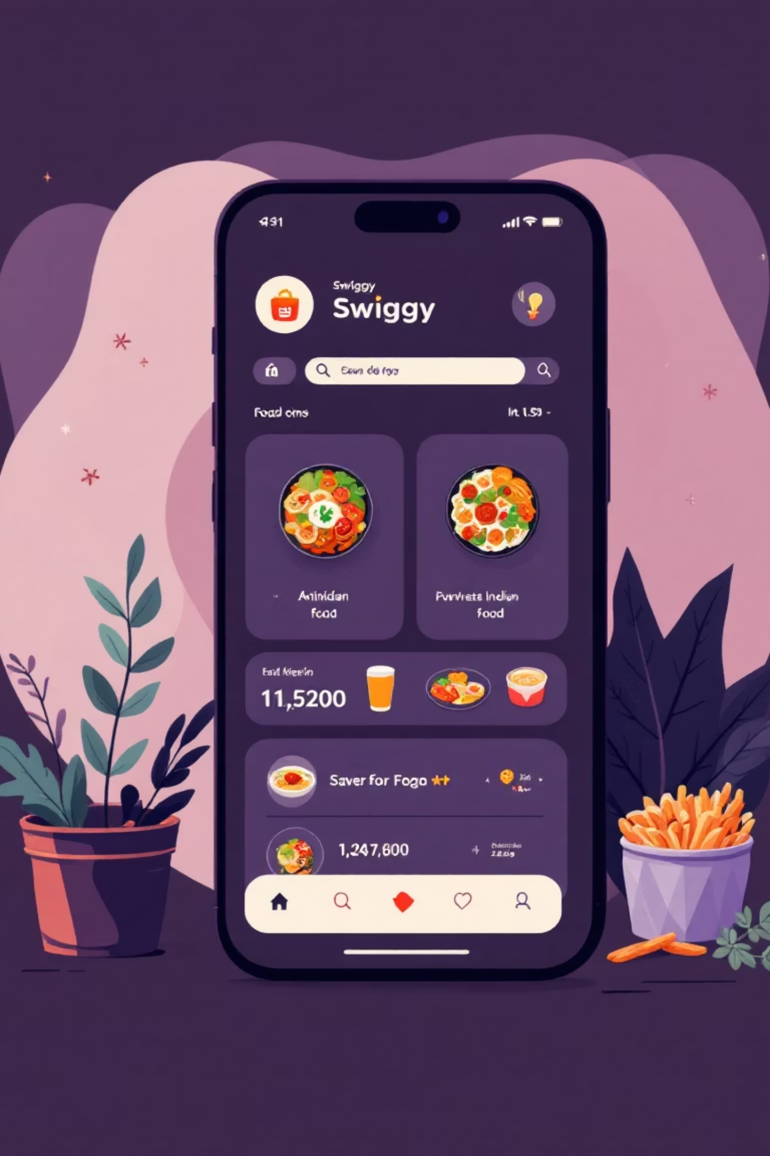

Swiggy Dataset Analytics
Comprehensive data analysis of India's leading food delivery platform using SQL to uncover market insights and growth opportunities.
Presented by -Suman Saha
Data Analyst
10-09-2025

Slide 2


Project Overview
About Swiggy
Swiggy stands as one of India's largest online food delivery platforms, connecting millions of customers with thousands of restaurants across the country.
Our Analysis
This project leverages SQL to analyze restaurant and menu datasets, extracting valuable insights on pricing strategies, customer preferences, and market dynamics.
MySQL

Slide 3
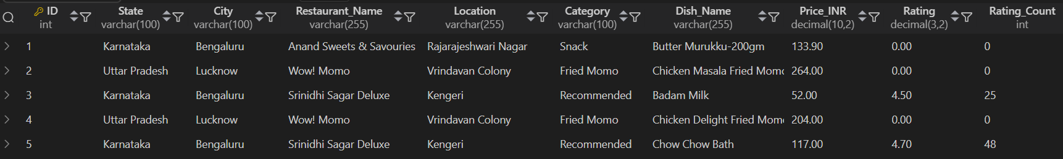
Dataset Deep Dive
Data Structure
Coverage & Scale
Data Quality
Primary Dataset: Swiggy restaurant database with 191293 records
Geographic Reach: Pan-India analysis
Cleaning Process: Enterprise-grade preparation
Comprehensive coverage across major metropolitan cities and emerging food delivery markets nationwide.
Duplicate record removal
State & City locations
Primary key establishment
Restaurant names & categories
Data validation checks
Dish details & pricing (INR)
Rating metrics & counts
QUERY : SELECT * FROM SWIGGEY;

Slide 4
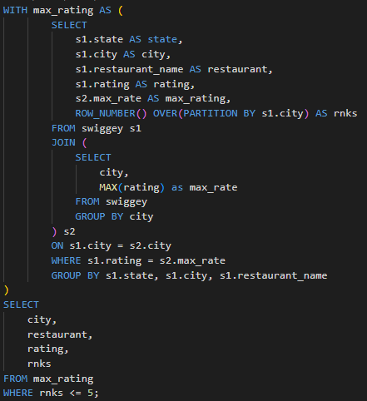
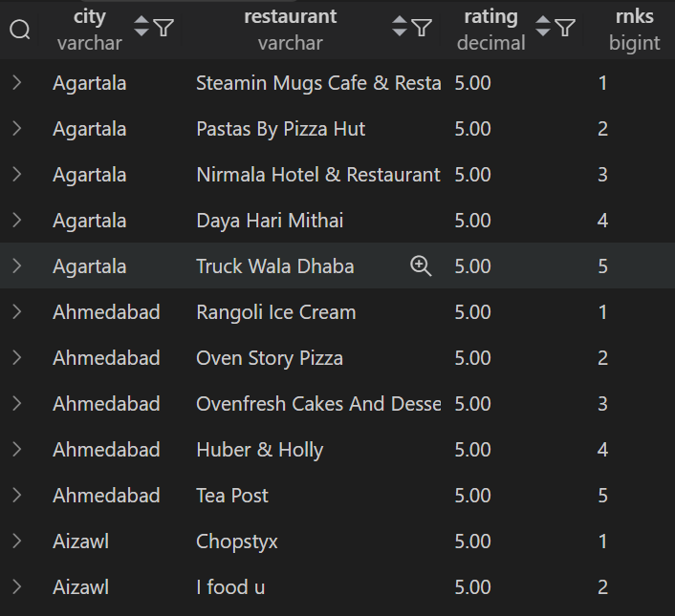
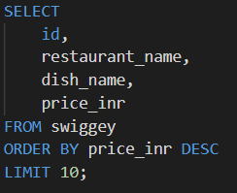
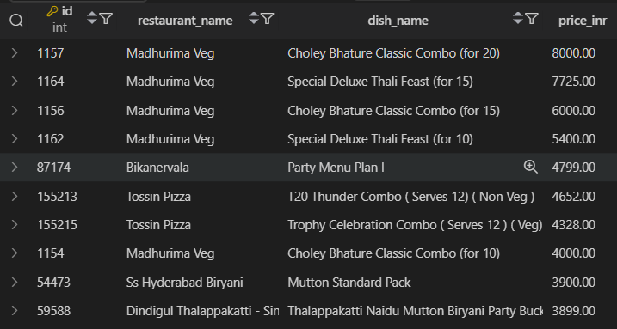
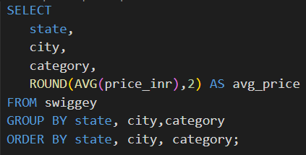
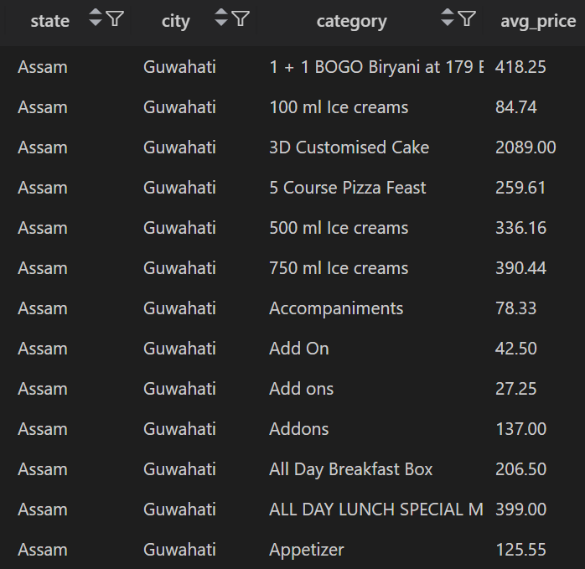
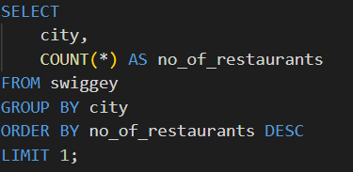
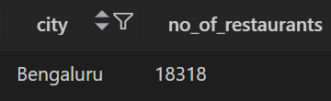
Key Analysis
-- Q2. List the top 5 highest-rated restaurants in each city.
QUERY
OUTPUT
-- Q1. Find the top 10 most expensive dishes in the dataset.
QUERY
OUTPUT
Insight: Helps identify premium dishes & pricing strategy.
-- Q3. Find the average price of dishes by category across all states.
Insight: Shows which restaurants dominate local customer satisfaction.
QUERY
OUTPUT
-- Q4. Identify the city with the maximum number of restaurants listed.
QUERY
OUTPUT
Insight: Reveals which food categories are premium vs affordable.
Insight: Identifies food delivery hotspots and urban market saturation.

Slide 5
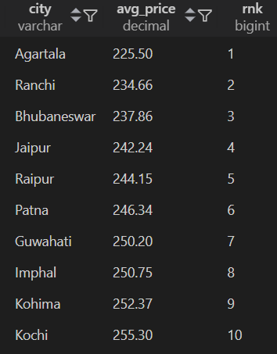
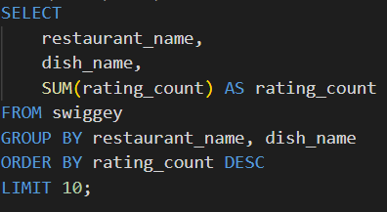
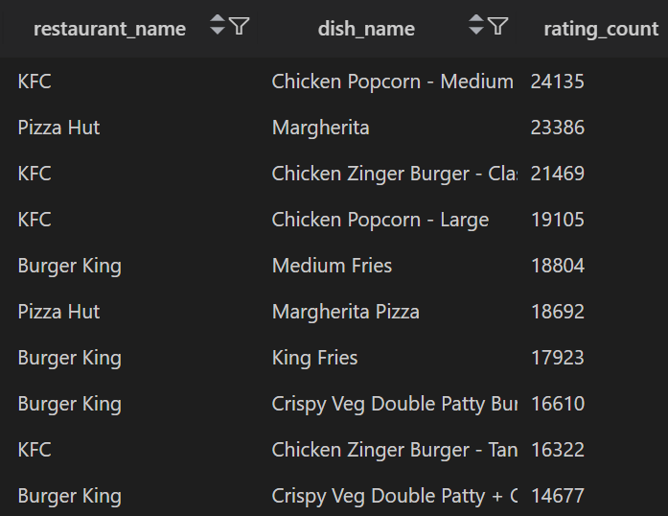
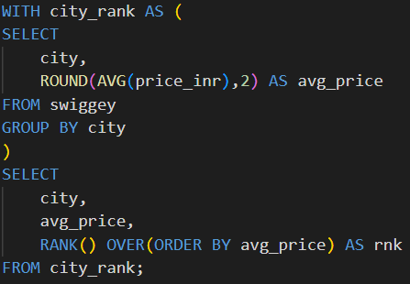
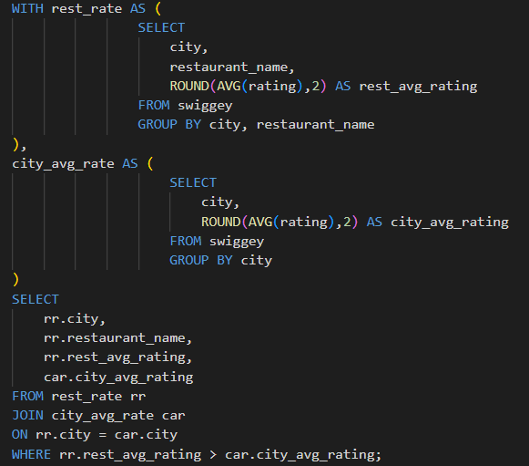
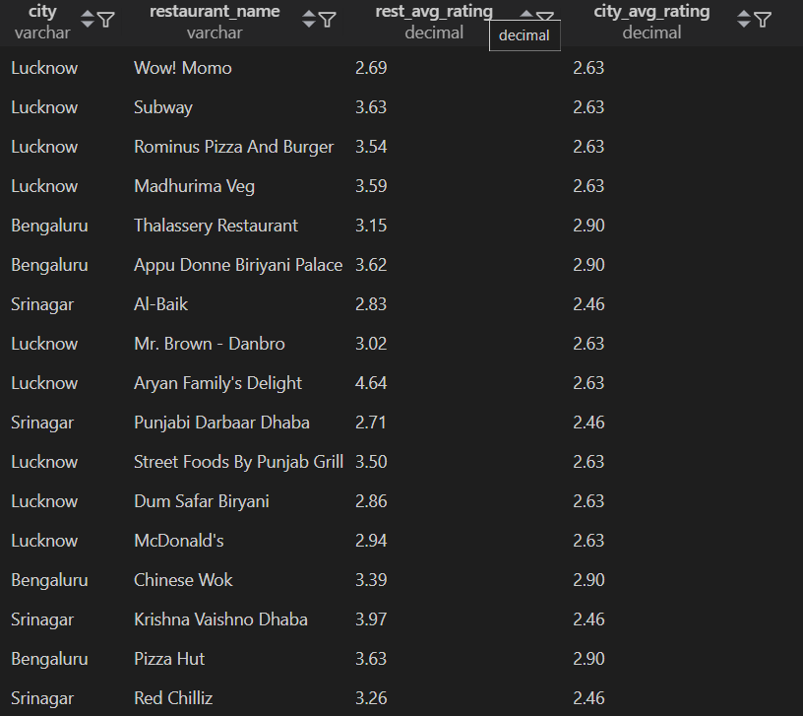
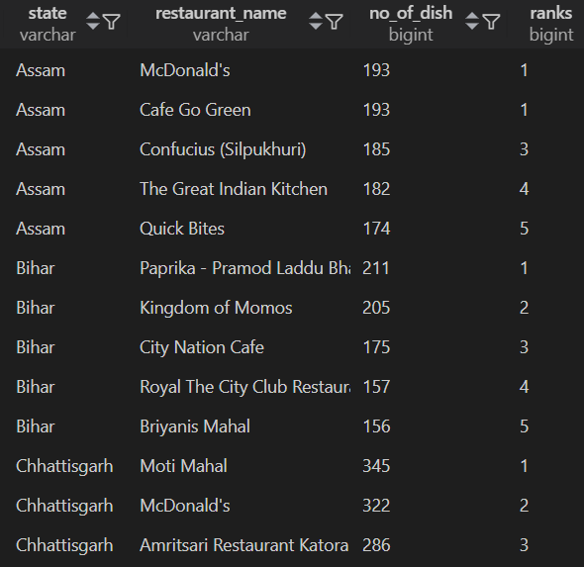
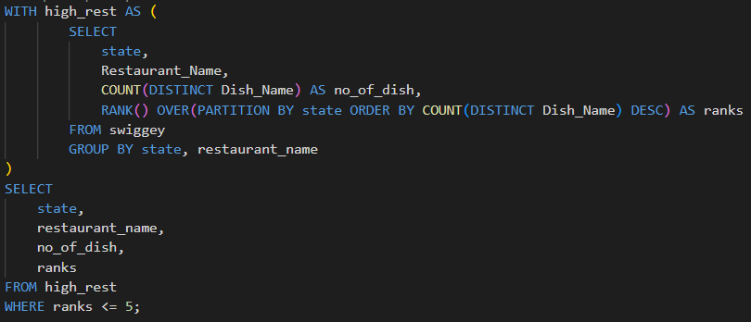
-- Q5. Show the top 10 most popular dishes (based on Rating Count).
-- Q6. Find the average dish price per city and rank the cities from cheapest to most expensive.
QUERY
OUTPUT
OUTPUT
QUERY
Insight: Highlights dishes that drive customer engagement nationwide.
Insight: Shows affordability index of cities; useful for promotions.
-- Q8. Find restaurants with rating higher than their city's average rating.
QUERY
OUTPUT
-- Q7. Get the top 5 restaurants in each state with the highest number of dishes listed.
OUTPUT
QUERY
Insight: Identifies versatile restaurants with wide menu variety.
Insight: Tests if expensive dishes actually lead to higher ratings.

Slide 6
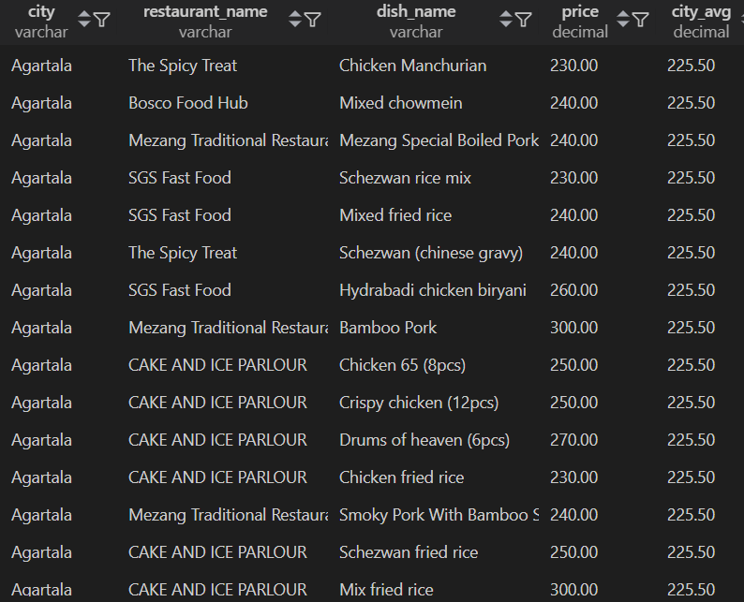
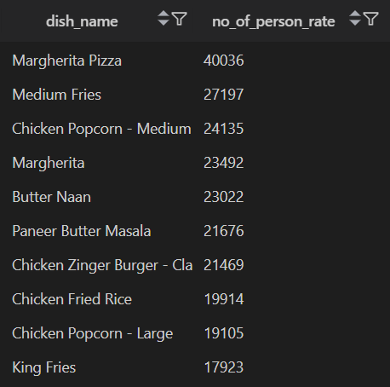
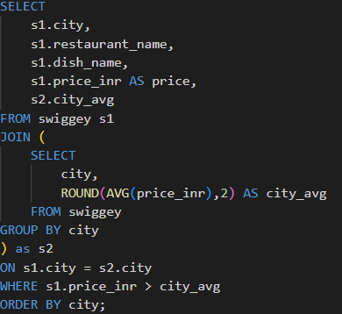
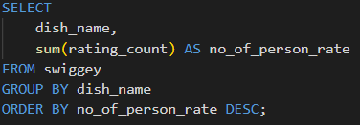
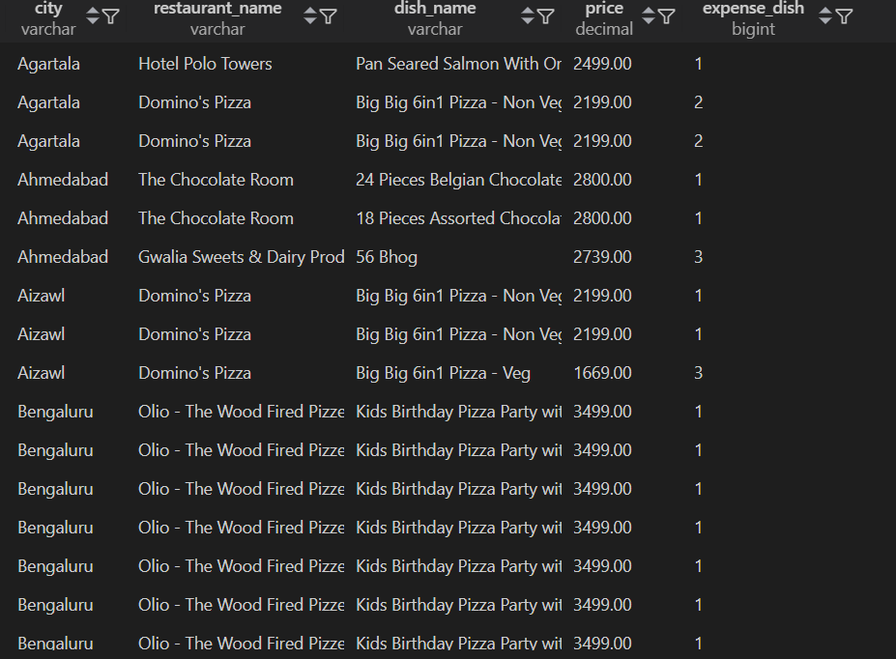
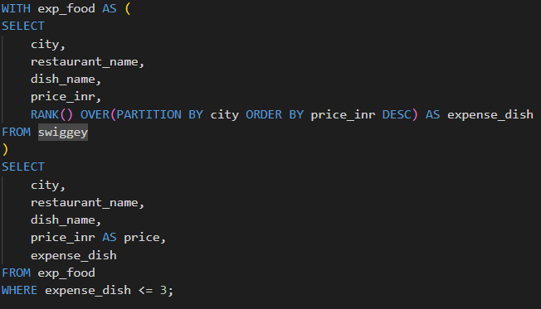
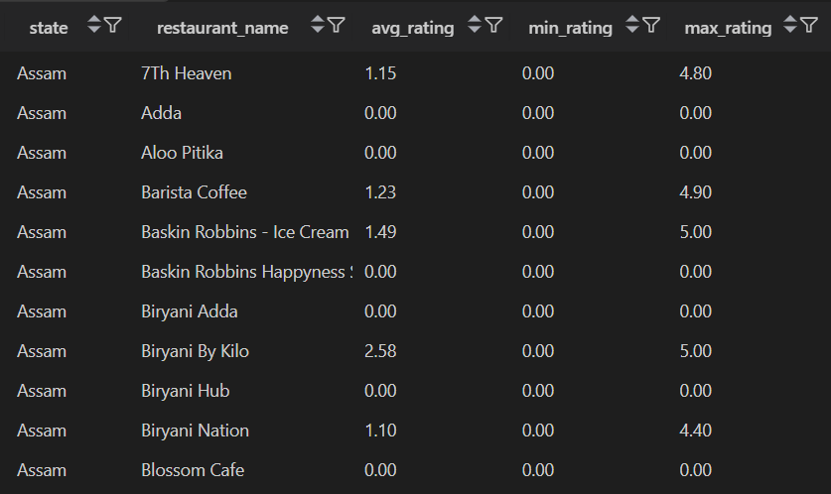
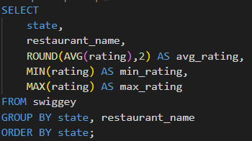
-- Q9. List dishes that have a price higher than the city’s average price.
-- Q10. Find the most common dish categories across India.
QUERY
OUTPUT
QUERY
OUTPUT
Insight: Detects premium-priced dishes per city; helps pricing strategy.
-- Q11. Find the top 3 most expensive dishes in each city along with their restaurant and price.
Insight: Identifies food preferences nationwide
QUERY
OUTPUT
-- Q12. Show the average, minimum, and maximum rating of restaurants in each state.
QUERY
OUTPUT
Insight: City-wise premium food analysis; helps luxury dining promotion.
Insight: Measures state-level service quality; identifies best/worst states.

Slide 7
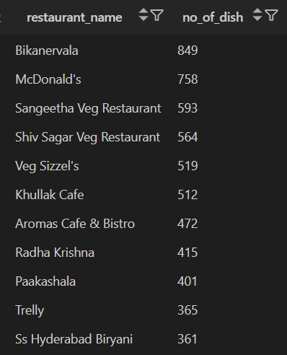
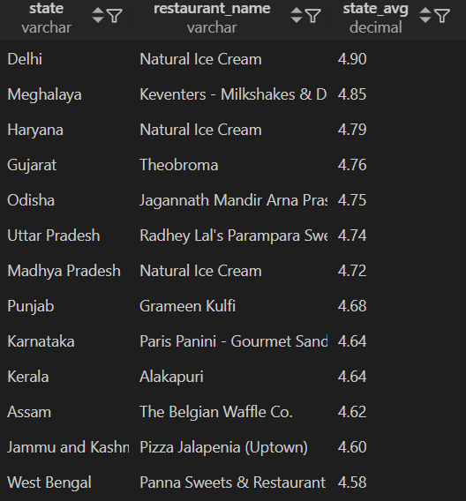
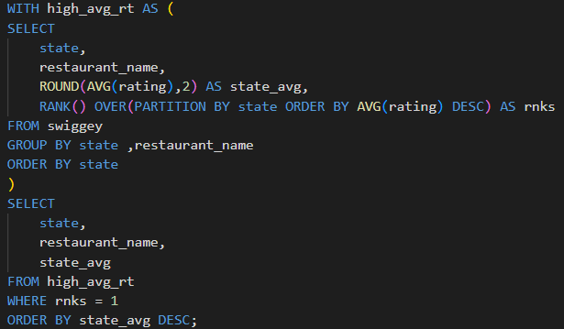
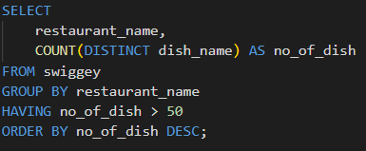
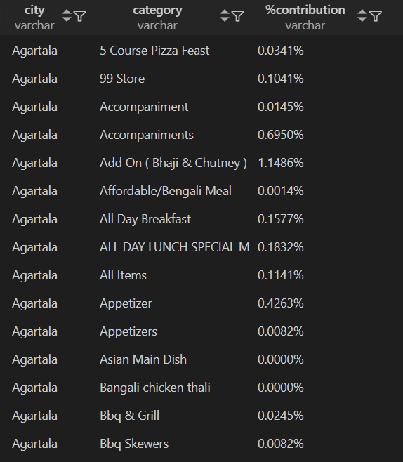
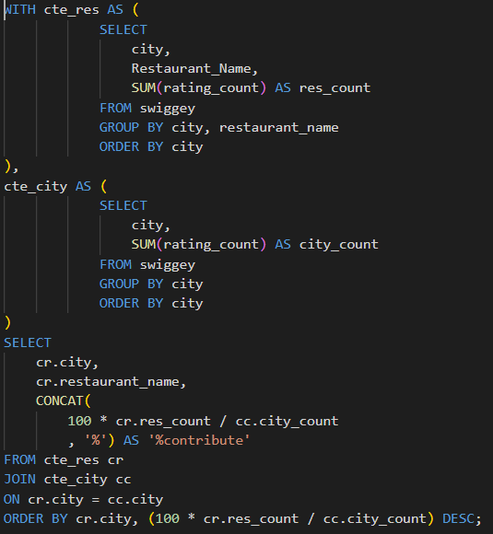
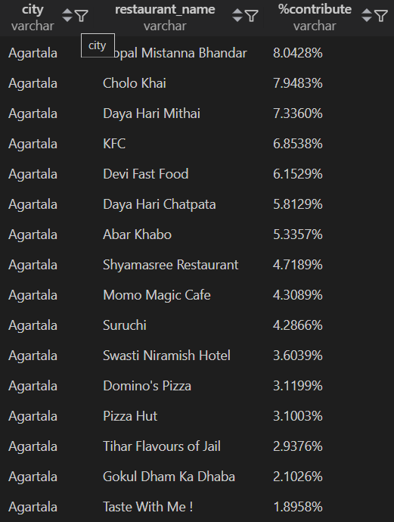
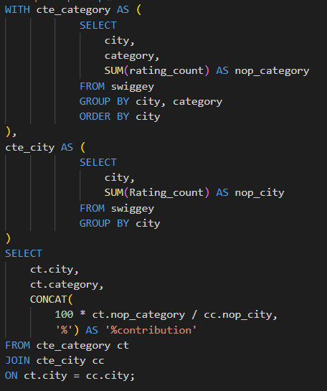
-- Q13. Find restaurants that offer more than 50 unique dishes in their menu per city.
-- Q14. Identify the restaurant(s) with the highest average rating in each state.
OUTPUT
QUERY
OUTPUT
QUERY
Insight: Detects large-menu restaurants; good for partnerships.
Insight: Recognizes top-performing restaurants per state.
-- Q15. Find the percentage contribution of each category to the total menu items in a city.
-- Q16. Find the percentage contribution of each Restaurant in a city.
OUTPUT
QUERY
OUTPUT
QUERY
Insight: Shows category diversity & dominance within each city.
Insight: Detects restaurant dominance in market share per city.

Slide 8


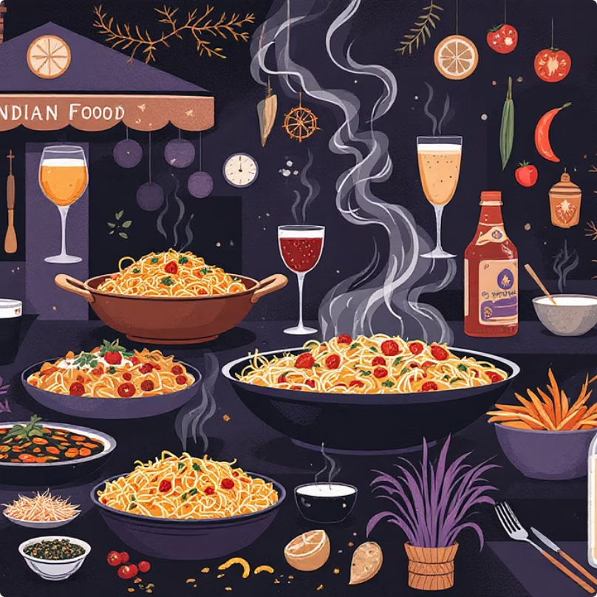
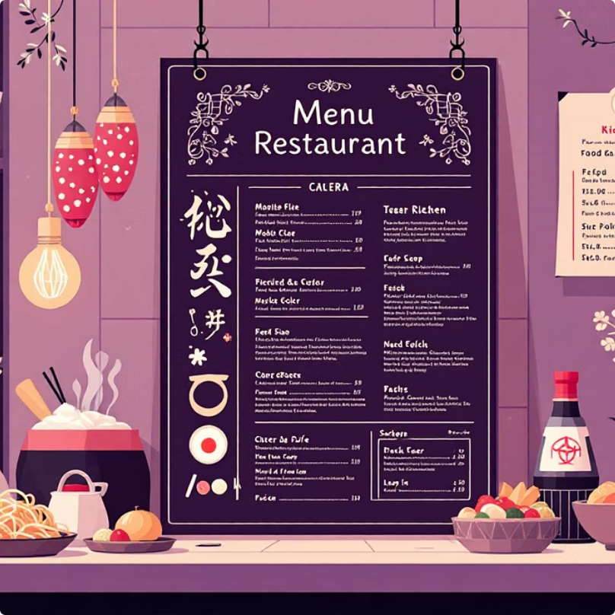
Strategic Business Insights
Marketing Amplification
Recommendation Engine
Pricing Strategy
Promote top-performing restaurants through targeted Swiggy advertising campaigns and featured placements.
Highlight popular dishes in AI-driven recommendation systems to increase order conversion rates.
Deploy city affordability insights to design targeted discount campaigns and promotional offers.
Use category preference data to personalize customer experiences.
Optimize pricing models using price-rating correlation analysis.
Leverage high-rated establishments to enhance platform credibility and customer trust.

Slide 9

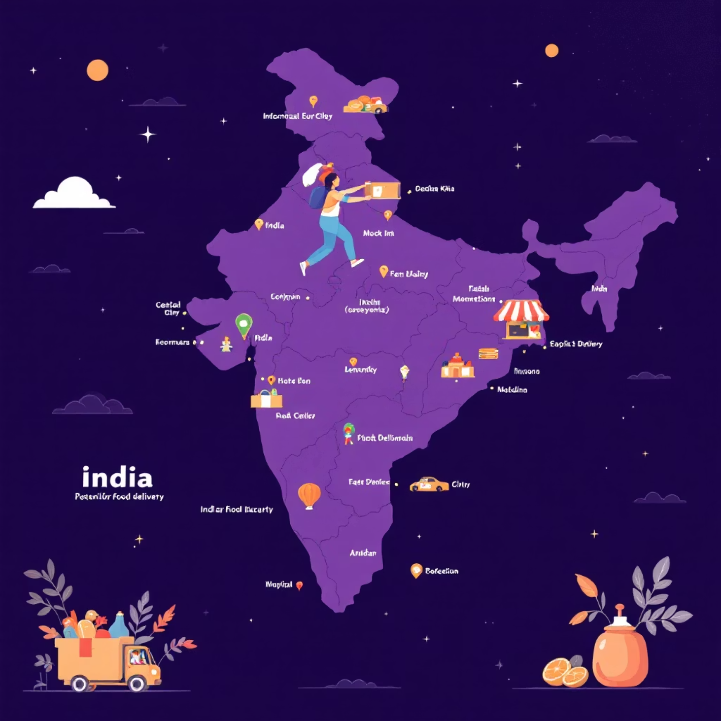


Growth & Expansion Opportunities
Market Expansion
Target states and cities with fewer restaurant partnerships for strategic growth and market penetration.
Category Optimization
Balance menu offerings using category contribution analysis to maximize customer choice and satisfaction.
Partnership Strategy
Prioritize high-variety restaurants (50+ dishes) for enhanced platform partnerships and exclusive deals.
"Data-driven insights enable Swiggy to make strategic decisions that drive both restaurant success and platform growth across India's diverse food delivery landscape."

Slide 10

Thank You

